Slide 1
Starbucks HR Management
Presented by: Hollie, Rachael, Shelby

Slide 2
Starbucks History
The company was started by Gorden Bowker, Jerry Baldwin , and Zev Siegl the first store opened in 1971. The first name was Starbucks Coffee Tea and Spices. Later the name was changed to the Starbucks Coffee Company. The owners were not originally skilled in the coffee business all they knew was that a good cup of coffee was hard to find. The three owners received training in the coffee business by working for Peet’s Coffee and Tea. The owner Peet roasted beans for Starbucks while he taught the owners how to be perfectionist in the business. The owner Peet from Peet’s Coffee and Tea roasted beans for the first year of Starbucks opening. The original idea of the store was not to sell coffee by the cup but to sell coffee beans along with coffee related merchandise and equipment. Siegl one of the owners was the only paid employee at the start of the business. He connected with the customers and was a retail guru.

Slide 3
Starbucks History
Starbucks continued to order their coffee beans from Peet’s until their was so much demand the supplier could not keep up. Then the owners purchased a used coffee roaster from Holand, they set up roasting operations and began experimenting with blends and flavors on their own. Baldwin became a great coffee roaster and Bowker was the marketer. In the 1970 ‘s during the Boeing crash in Seattle Starbucks survived and it was said that Starbucks sales helped towards economic recovery. One of the owners sold out of the company Zev Siegl went on to pursue other interests. Baldwin served as presedent as Bowker was still invoked but also had other interests. In 1984 a new player was added to the Starbucks board Howard Schultz.

Slide 4
Starbucks History
Schultz was the one with the idea to actually serve coffee he brought the idea to the founders. They tested the idea in one store location in Seattle. The response was overwhelming but the founders did not want to take the coffeehouse concept any further they wanted to focus on coffee roasting. Then in 1984 the founders bought out Peet’s Coffee and Tea. Shultz continued to open up Giornale coffee company fascinated with the idea he had gotten from Italy. He wanted to serve coffee in these stores not just coffee beans. Back by investors (including Starbucks) he grew and was profitable then eventually bought out the founders of Starbucks. Then changed the name to Starbucks Corporation.

Slide 5
http://youtu.be/9pYCsKAiyuk

Slide 6
Workforce Mindset and Culture
Starbucks helps employees to grow and has a mindset that the employees should grow as fast as the company grows as C.E.Os. are chosen internally.
Starbucks calls their employees partners.
The partners do surveys every 18 months answering questions about their overall job satisfaction and commitment to the company.
Starbucks pays their employees to fill out the surveys by having them do it on work time.
In doing this they align workers with their key values of creating a workplace were people treat each other with respect and dignity.
District managers and functional departments of the company review the surveys and respond to the employees.
65% of executives indicate that the do not do this

Slide 7
HR Practices

Slide 8
HR Practices
Training
Programs: Coffee Master Program
High priority to company’s goal of building brand
Example) Shut down operations for one day in 2008
Hiring/Recruiting
Taleo screening system
Fitting in with Starbuck’s culture
HR Administration
Employees Rewards System
Benefits (full/part time)

Slide 9
HR Systems Aligning, Integrating, Differentiating

Slide 10
Aligning Strategy with HR functions
“To inspire and nurture the human spirit – one person, one cup and neighborhood at a time”
Training
Aligns their strategy of giving customers the ultimate “customer experience” through development of programs, lean techniques – “finding new ways to deliver world-class customer service and perfect beverages while keeping costs in line and our partners engaged”
Hiring/Recruiting
Aligns their strategy by ensuring they have the best employees of customer service through development of their own screening system
HR Administration
Aligns their strategy ensuring they retain their partners through development of rewards system and having great benefits package for FT/PT

Slide 11
HR Systems to Integrate Strategy
Integrative Linkage
HRM is involved in both strategy formulation and strategy implementation
Performance Management Systems
“Your Special Blend”
Starbucks Rewards Model for Employees
Bonuses based on goals achieved, Free Coffee, Tuition Assistance, Partner Discounts, 30% Store Discounts
Starbucks Growth Model
Model that helps improve employee’s growth in company

Slide 12
Differentiating Strategy with HR functions
HR continues to develop their functions/practices based on Starbuck’s strategy
HR will implement certain aspects of strategy (Integrative Linkage)
Hiring the right employees to meet the goals of the company’s strategy
Ensure hired employees are successful in meeting goals leading up to overall strategy

Slide 13
HR Workforce Competencies

Slide 14
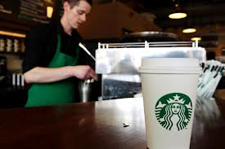
Competencies (Skills)
Strategic Partner: grocery stores, drug stores, (Barnes and Noble/ Target), international markets: China, India, Brazil, by 2012 hopes to be in Vietnam
Change agent: demographics and store locations
Employee Advocate: reflects the strength and resiliency of Starbucks Business Model
Administrative expert: to attract world class people who have values which align with culture of the company

Slide 15
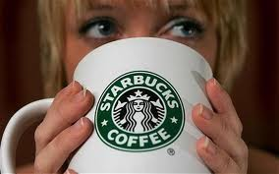
“We have always believed the way to build a great enduring company is to strike a balance between profitability and a social conscience”

Slide 16
Cons and Pros of their HR
Cons
Employees through surveys answered they wanted to better understand career progression through the organization
Finding and keeping high-quality managers to keep the culture strong
Pros
HR is a strategic partner
Strong culture in the workplace “partners”
Able to retain partners with culture, benefits, rewards

Slide 17
Opportunities for Improvement/Recommendations
Recommend to grow globally with new coffee products
Recommend when global, to respect cultural differences coffee products to fit the culture (ex. Seattle (blueberry) vs. China (black sesame seed) muffin)
Continue to decentralize- keep trust with people in market place
Remain true to the values of the company and quality of the coffee
To remember growth is not to be a strategy; “it’s a tactic”
To keep the company disciplined for profitable growth

Slide 18
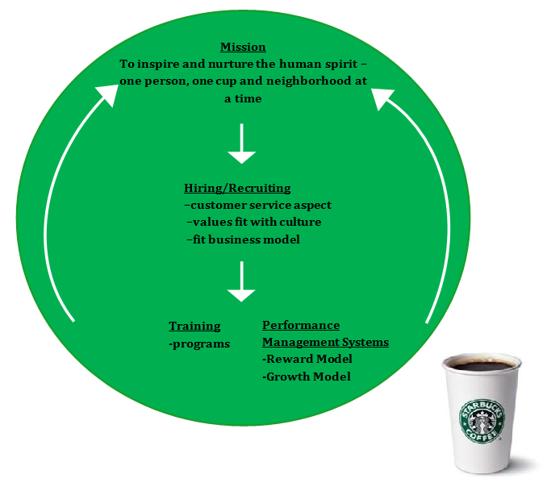
Visual HR Scorecard

Slide 19
Annotated Bibliography
http://investor.starbucks.com/phoenix.zhtml?c=99518&p=irol-reportsannual – 2011
The annual report give detailed information about the company business operations, financial, management, market disclosures,controls/ procedures, etc. The point of this source is to see Starbucks as a whole. The annual report helps to see how the Company is growing and developing.
Becker, B., Huselid, M., & Ulrich, D. (n.d.). The hr scorecard. Boston, MA: Harvard Business School Press. This book has helped the group develop an HR scorecard for Starbucks through knowing how to analyze business aspects of their human resources and align, integrate, and differentiate it with their strategy.
Bussing-Burks, M. (2009). Coffee master program [How Starbucks Moved Ahead of the Competition]. In Starbucks (pp. 62-63). Santa Barbara, CA: Greenwood Press. This section of the book explains some of the training that Starbucks offers to its employees, which I thought would be great evidence showing the company invests a lot into their employees to meet their goals/strategy.

Slide 20
Annotated Bibliography
Cohn, J. M., Khurana, R., & Reeves, L. (2005). Growing Talent as if Your Business Depended on It. (cover story). Harvard Business Review, 83(10), 62-70. The article explained the business ideas of the Starbucks Company. It informed us that C.E.Os. are internally picked. I decided to use the information towards the idea that is a strategic human resources advantage.
Leung, C. (2006). CULTURE CLUB. Canadian Business, 79(20), 115-120. The article talked about the importance of business culture. They said that Starbucks did things that 65% of executives surveyed said they do not do. I used the article to back up my understanding of the Starbucks culture.
Moe, M. (2006). Star gazer [The Power of Growth - The Magic of Compound Interest]. In Finding the next starbucks (pp. 26-31). London, England: Penguin Books. In this section of the book, the author interviews the CEO of Starbucks. I was able to use information he stated in the interview to show Starbucks strategy of growth and that they see human resources is also a key aspect in the company.

Slide 21
Annotated Bibliography
Noe, R., Hollenbeck, J., Gerhart, B., & Wright, P. (2013). Human resource management (8E ed.). New York, NY: McGraw-Hill/Irin. This book uses Starbucks as an example for gaining a competitive advantage in human resources. In this presentation, the group reflects on the training Starbucks invests in for their partners, the perks of being a partner, how they use integrative linkage when it comes to their strategy, as well as performance management in the workplace.
Schultz, H., & Gordon, J. (2011). A new blueprint for profitable growth, expanding our global presence - while making each store the heart of local neighborhoods, delivering a sustainable economic model [Tribute]. In Onward (pp. 315- 325). New York, NY: Rodale. The Tribute section of this book I felt had highlighted some of the techniques Starbucks has in place that makes them so successful. In my presentation, I will discuss their unique growth model and lean techniques.
Starbucks quest for healthy growth: an interview with Howard Schults. Mckinsey Quarterly. June 2011
Interview gave perspective from the owner of the company. Its point was to get a better understanding of the healthy growth of Starbucks. The interview gave insight on how Starbucks is looking at past mistakes and learning from them to help the growth of Starbucks and the growth of Starbucks globally.

